Slide 1


BE-Computer Science & Engineering (Cybersecurity)
Semester Review Presentation
BE Project-I Presentation | A.Y. 2026-27 (Odd)
TnP Connect
Unified Training & Placement Management Solution
Presented By:
1. Neev Jain (31)
2. Pratyush Pandey (34)
3. Ankush Sahu (45)
Name of Guide:
[Guide Name]

Slide 2


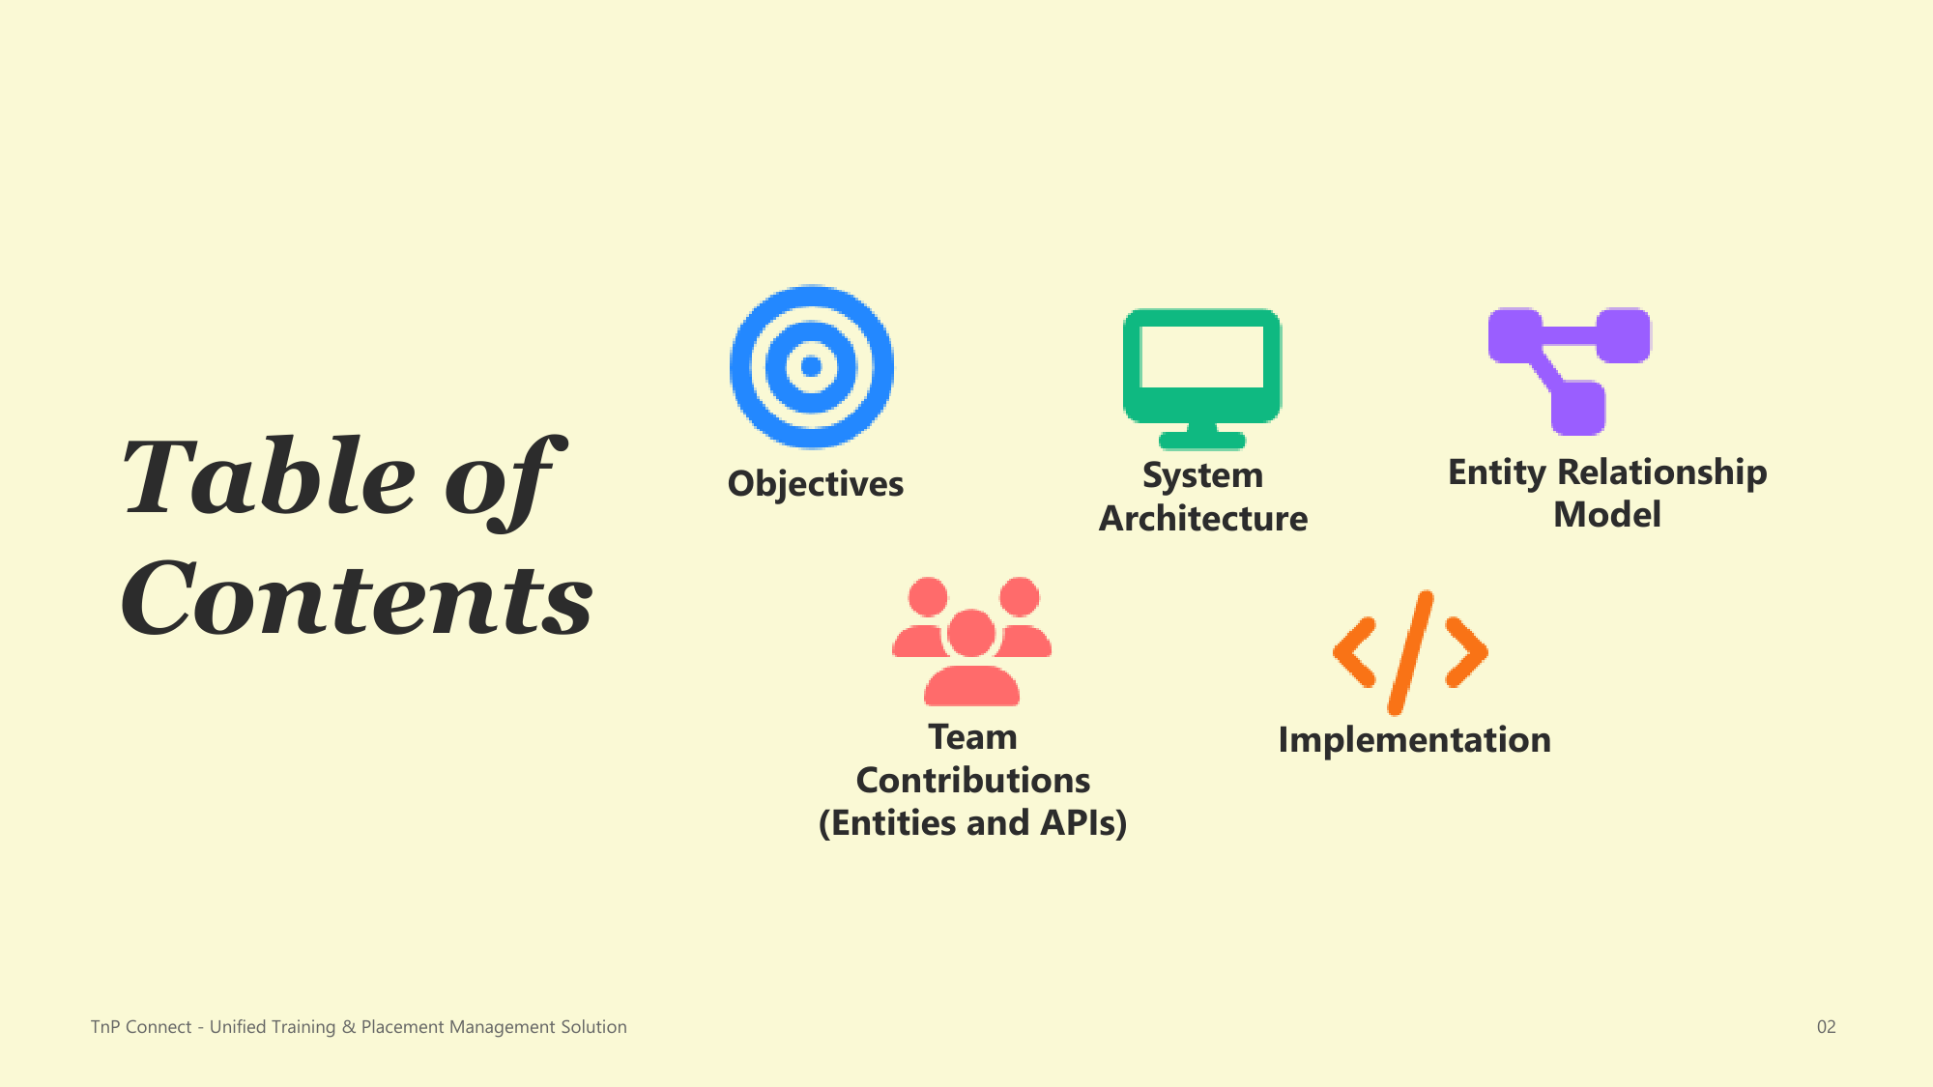
Table of Contents
2

Slide 3
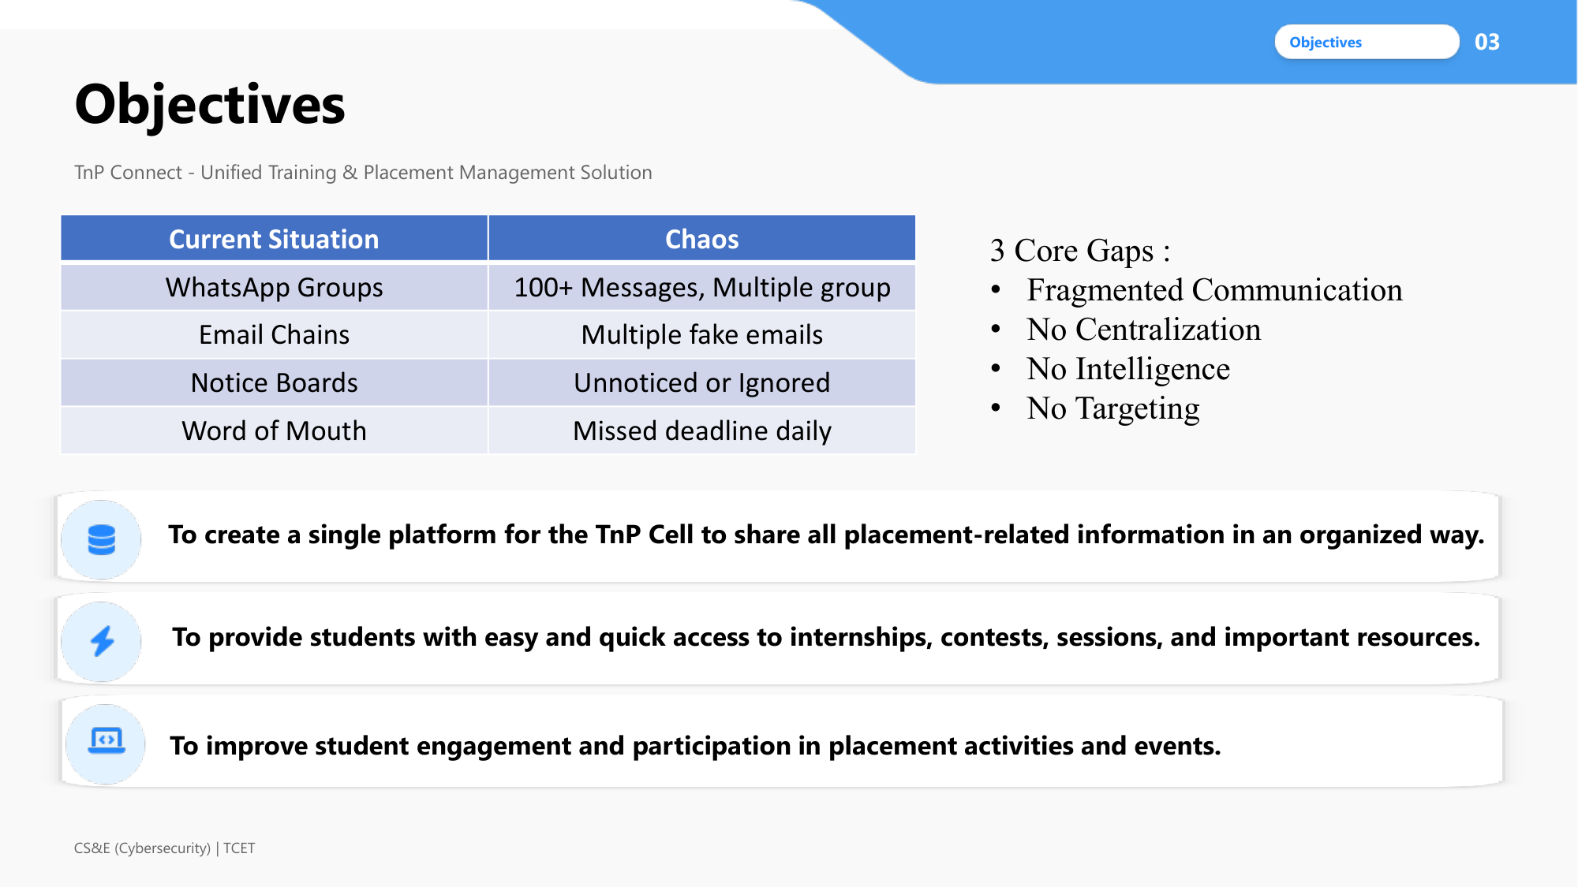
Objectives
3

Slide 4
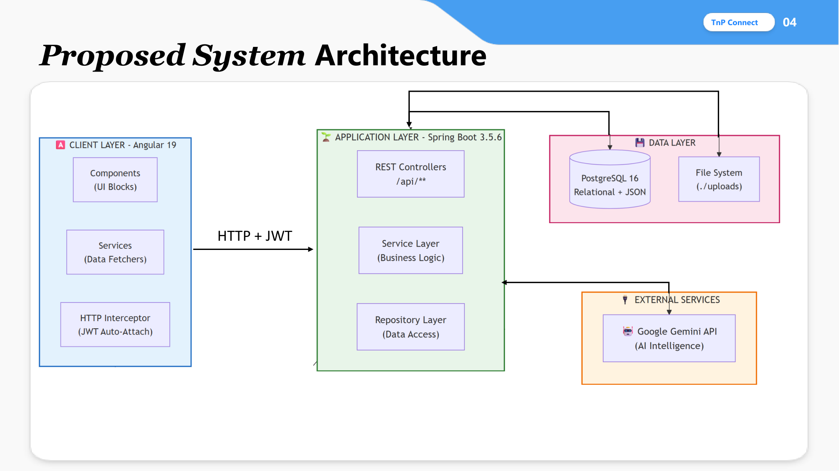
Proposed System Architecture
4

Slide 5
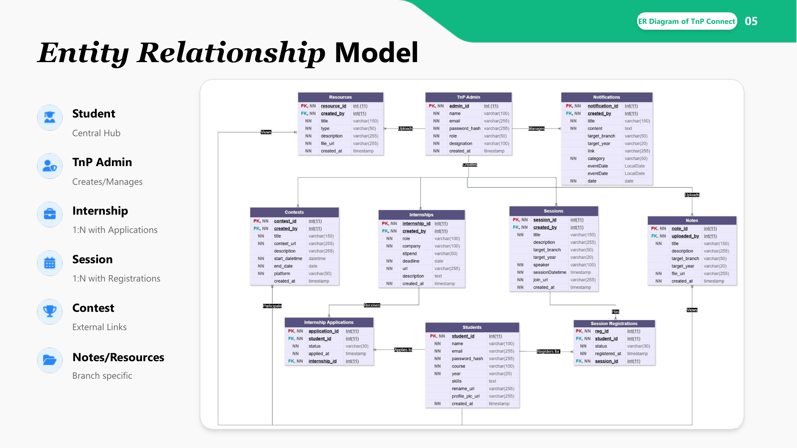
Entity Relationship Model
5

Slide 6
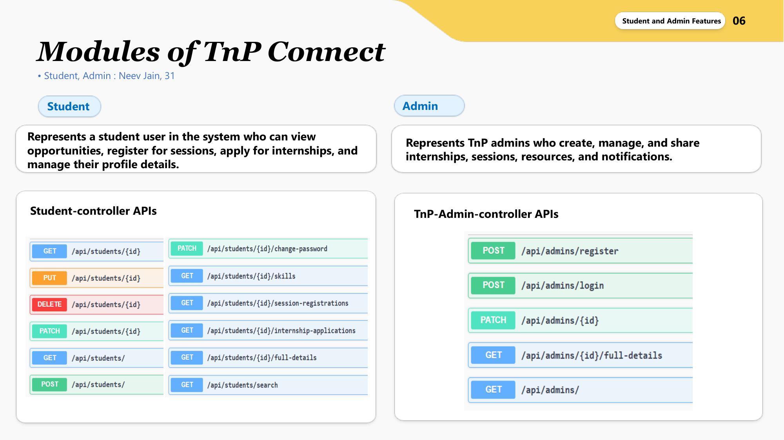
Modules - Student & Admin
6

Slide 7
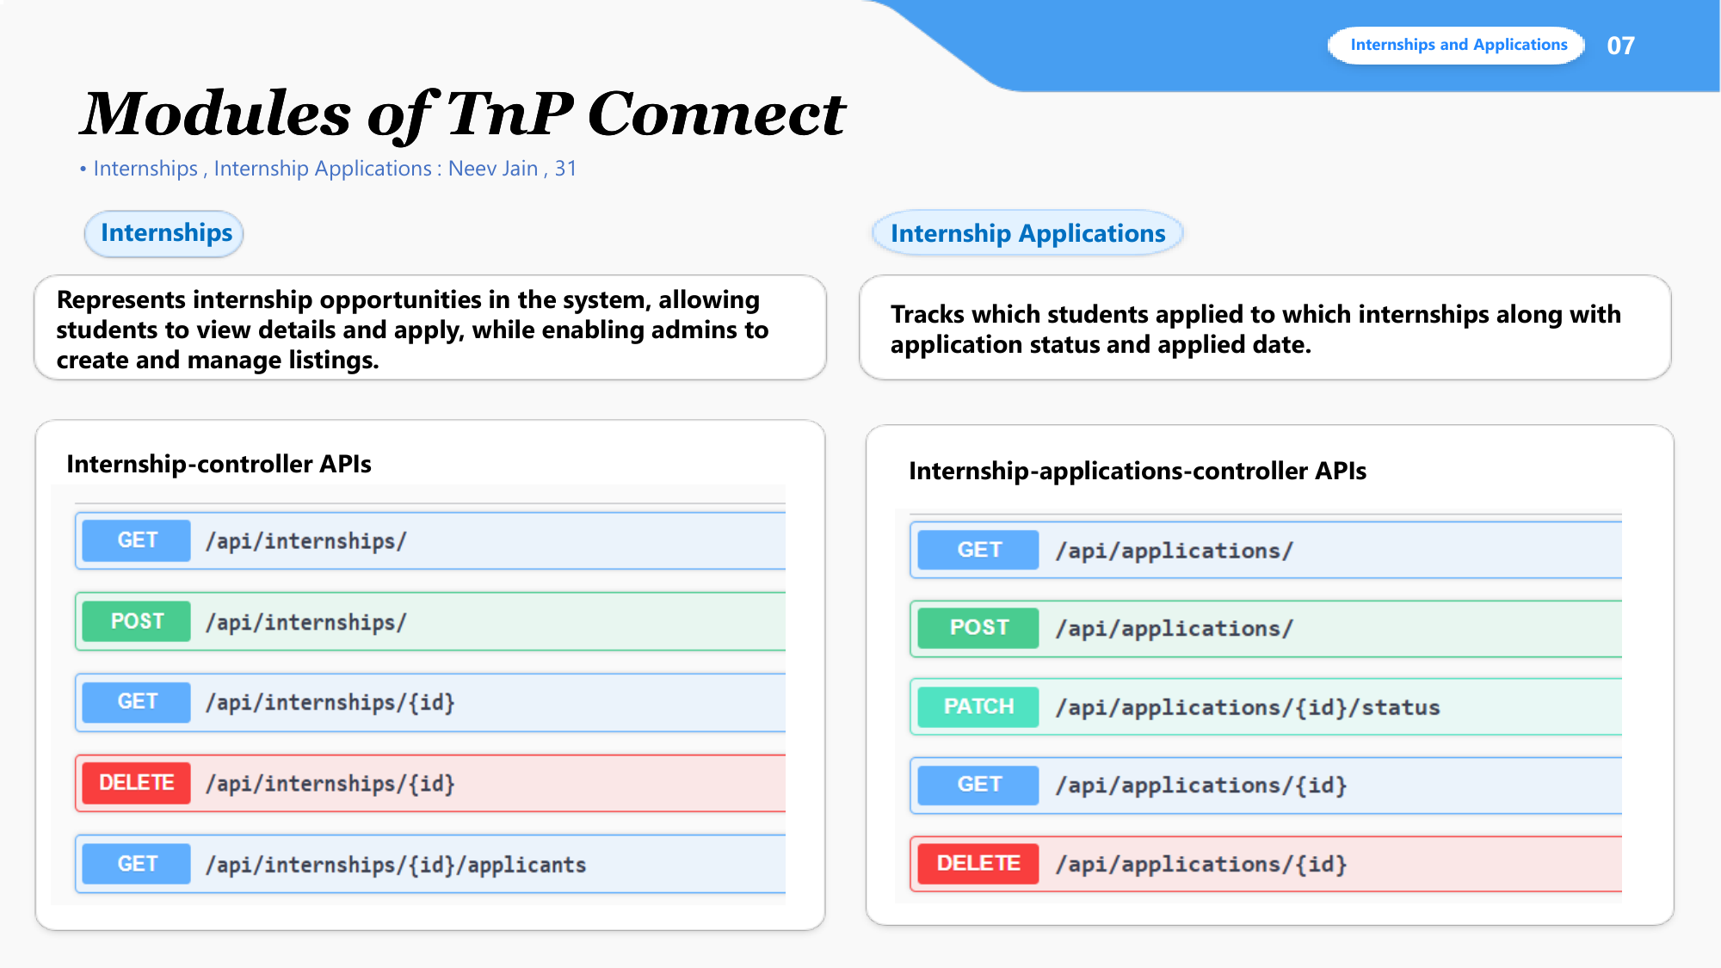
Modules - Internships & Applications
7

Slide 8
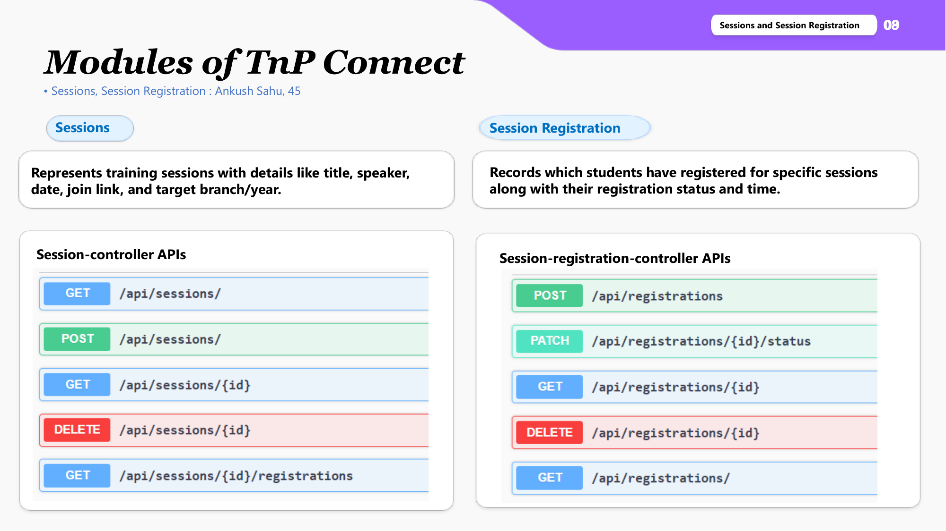
Modules - Sessions & Registration
8

Slide 9
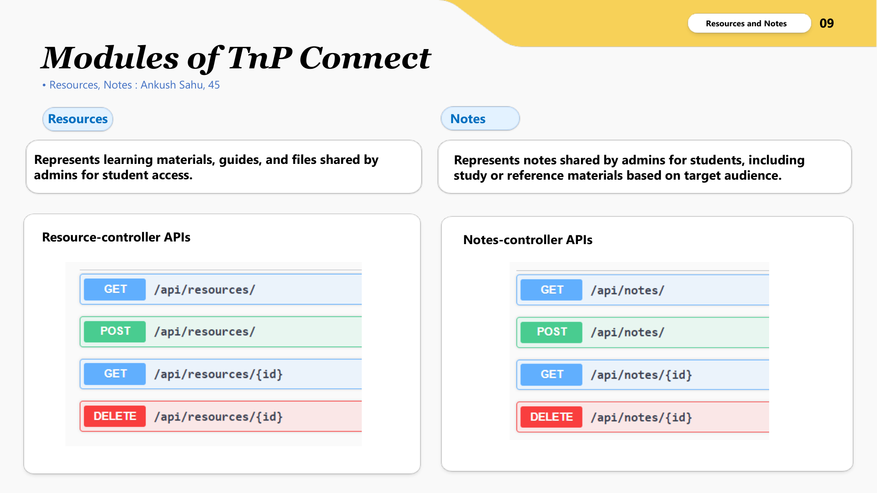
Modules - Resources & Notes
9

Slide 10
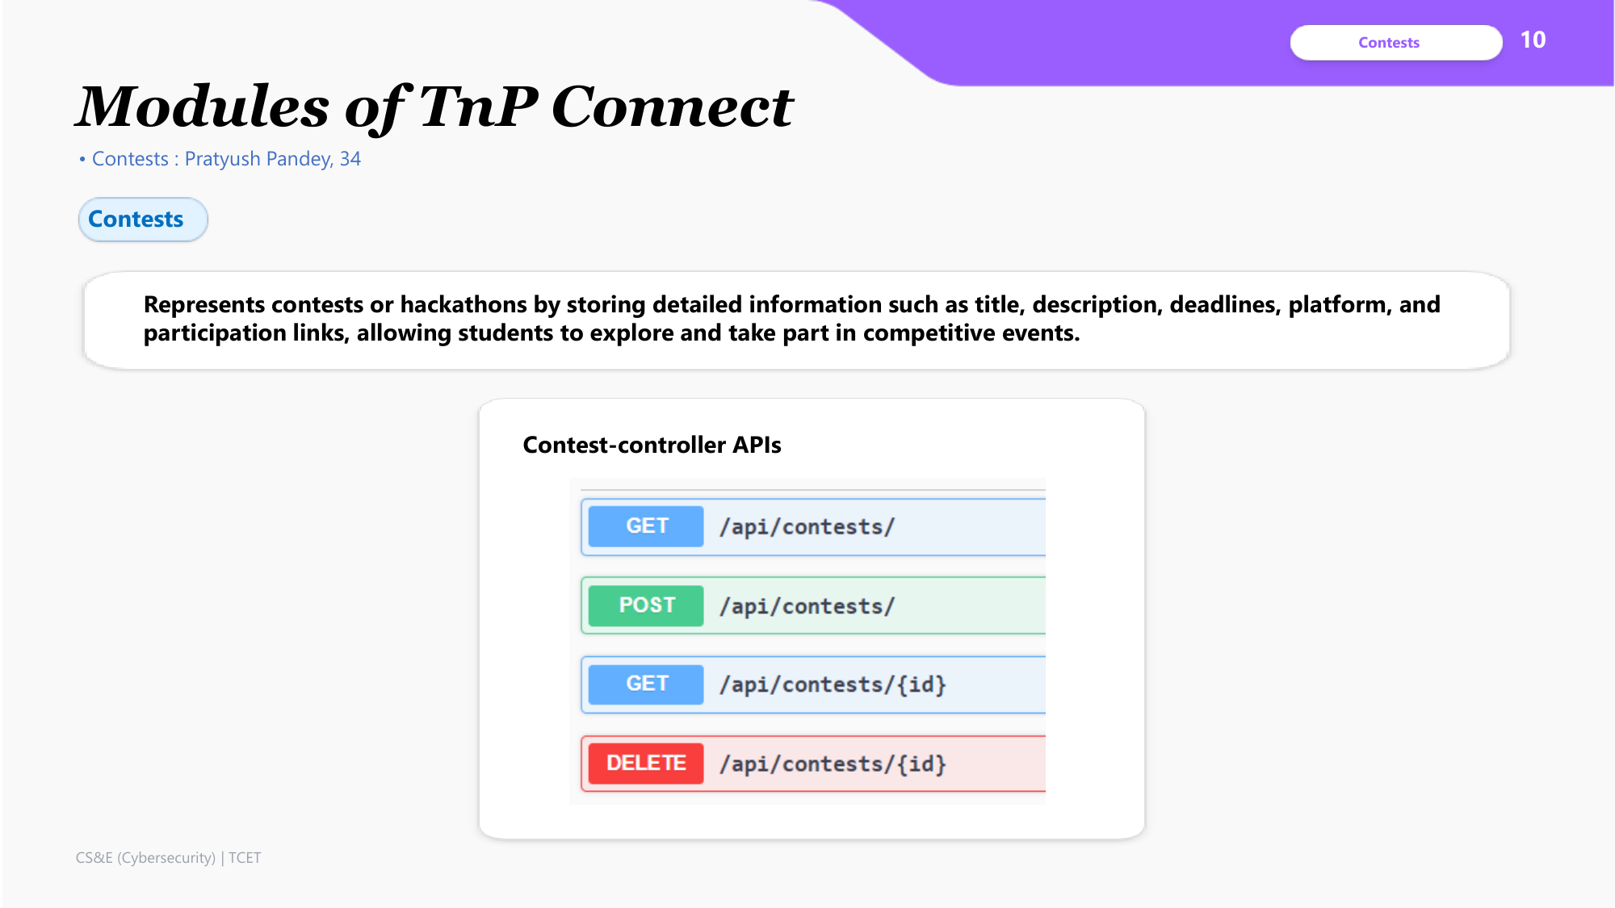
Modules - Contests
10

Slide 11
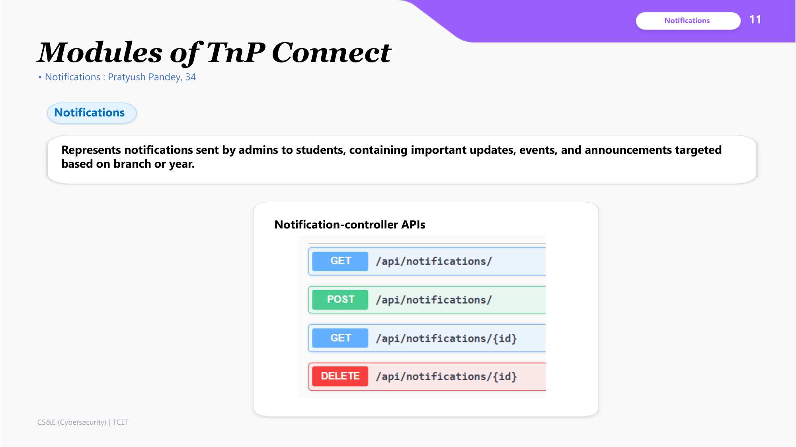
Modules - Notifications
11

Slide 12
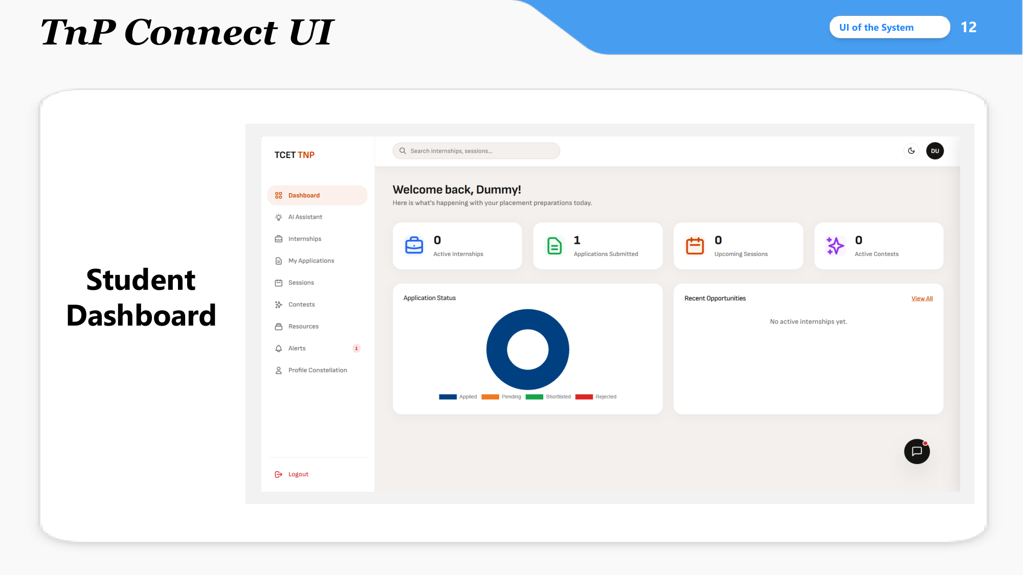
UI - Student Dashboard
12

Slide 13
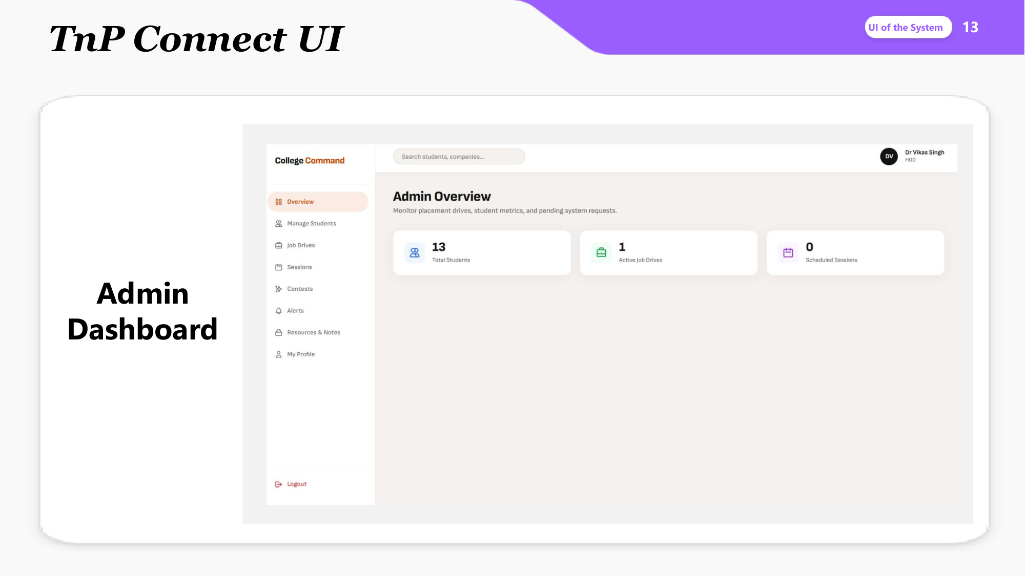
UI - Admin Dashboard
13

Slide 14
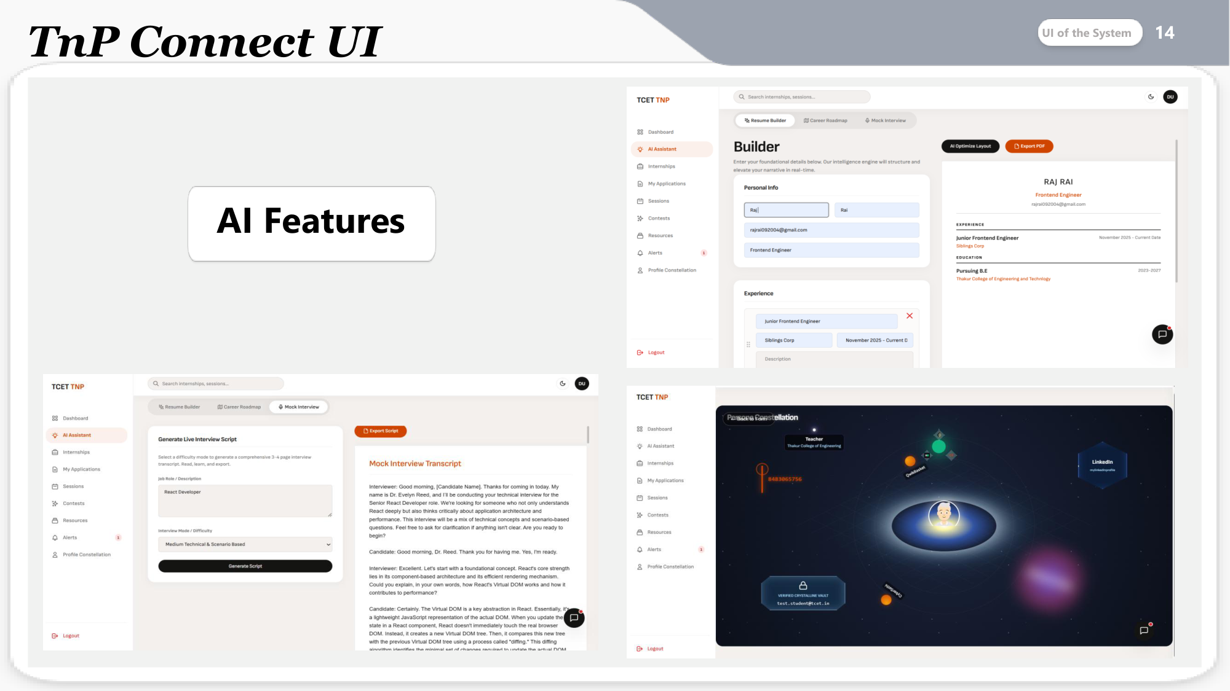
UI - AI Features
14

Slide 15
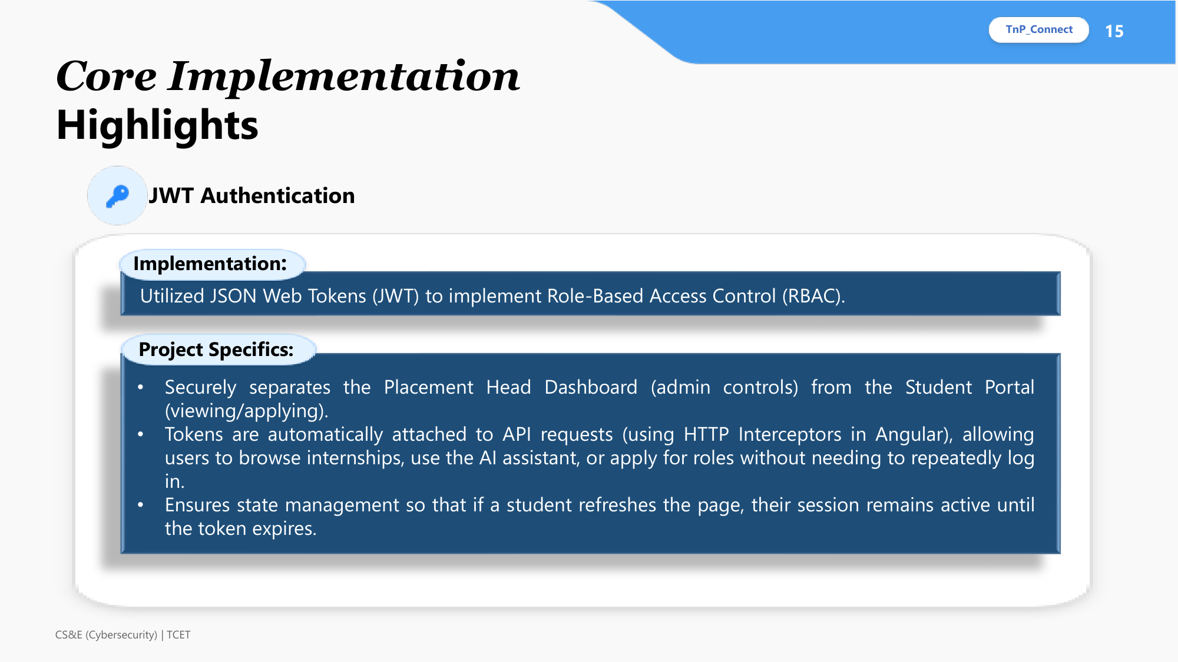
Implementation - JWT Authentication
15

Slide 16

Implementation - CRUD Operations
16

Slide 17
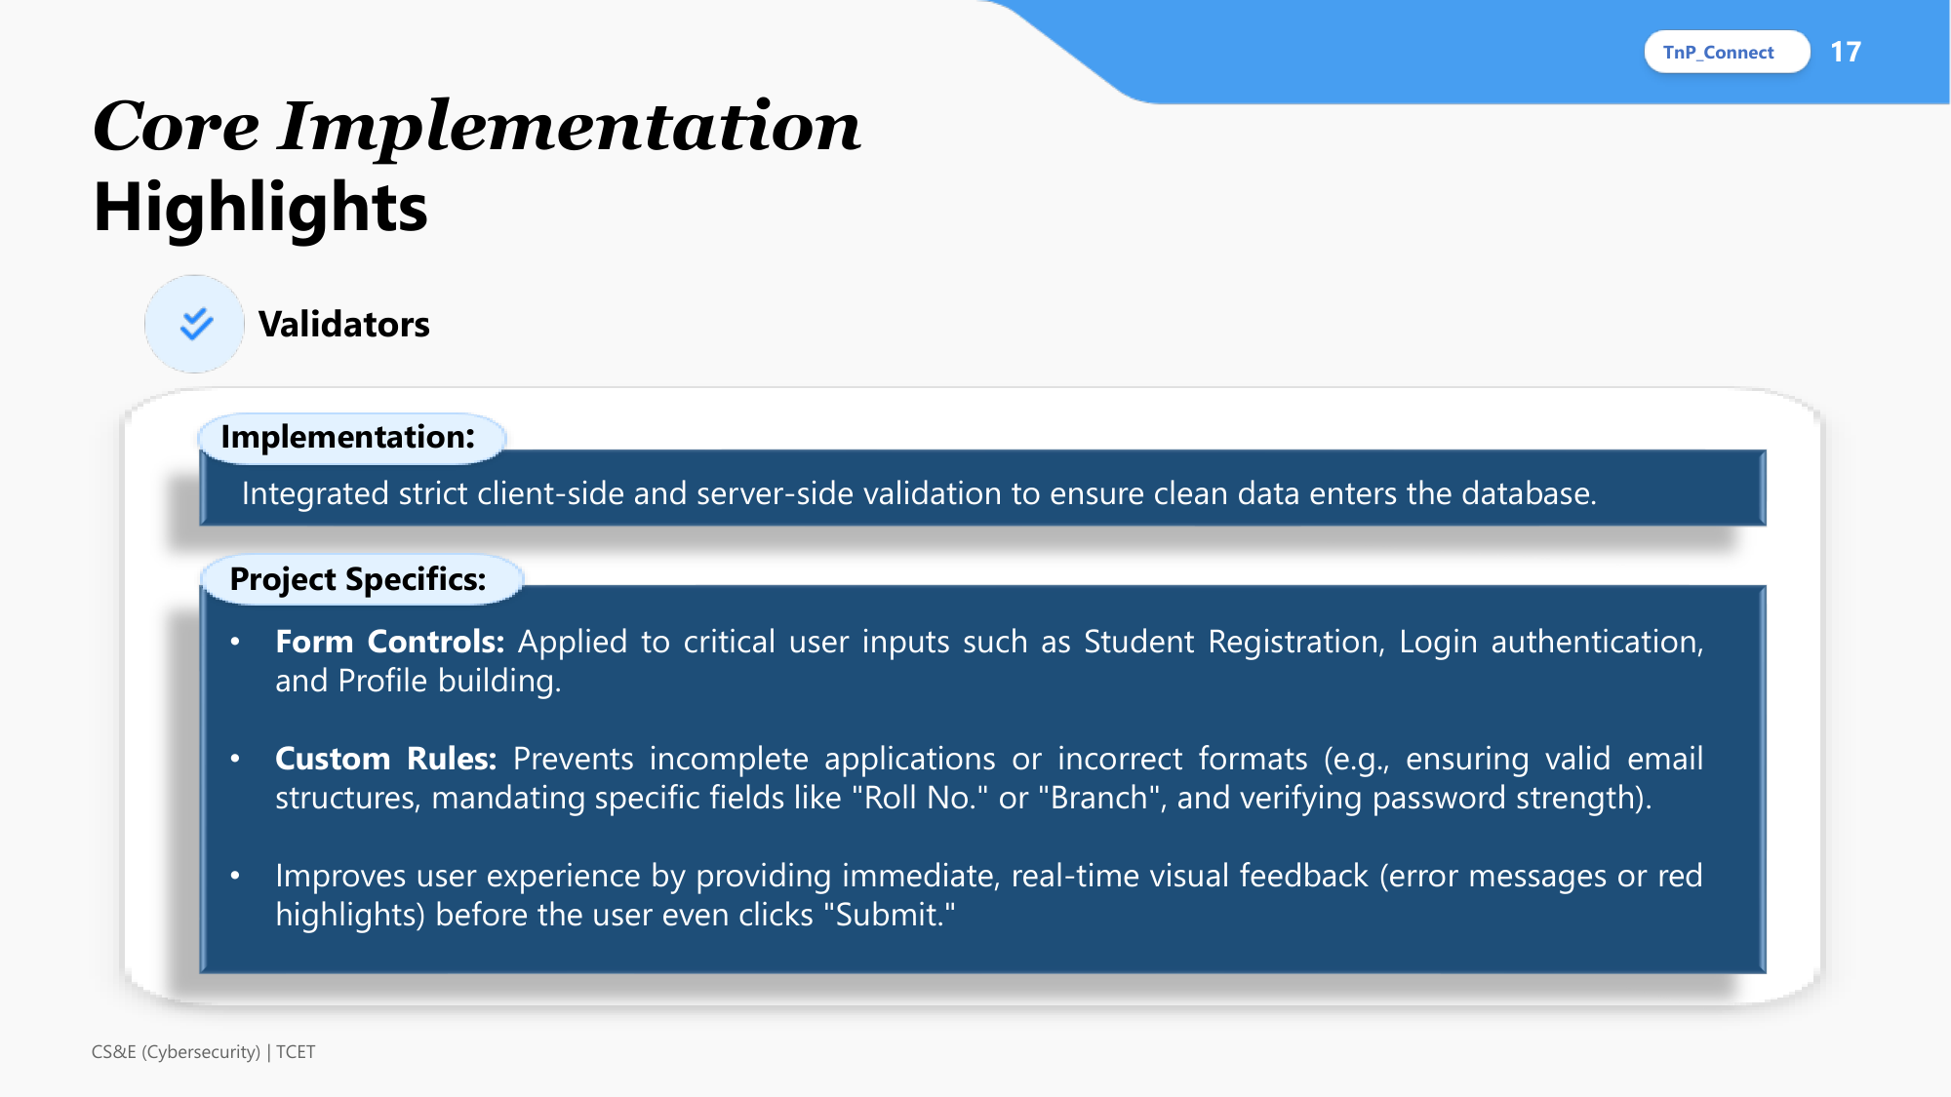
Implementation - Validators
17

Slide 18
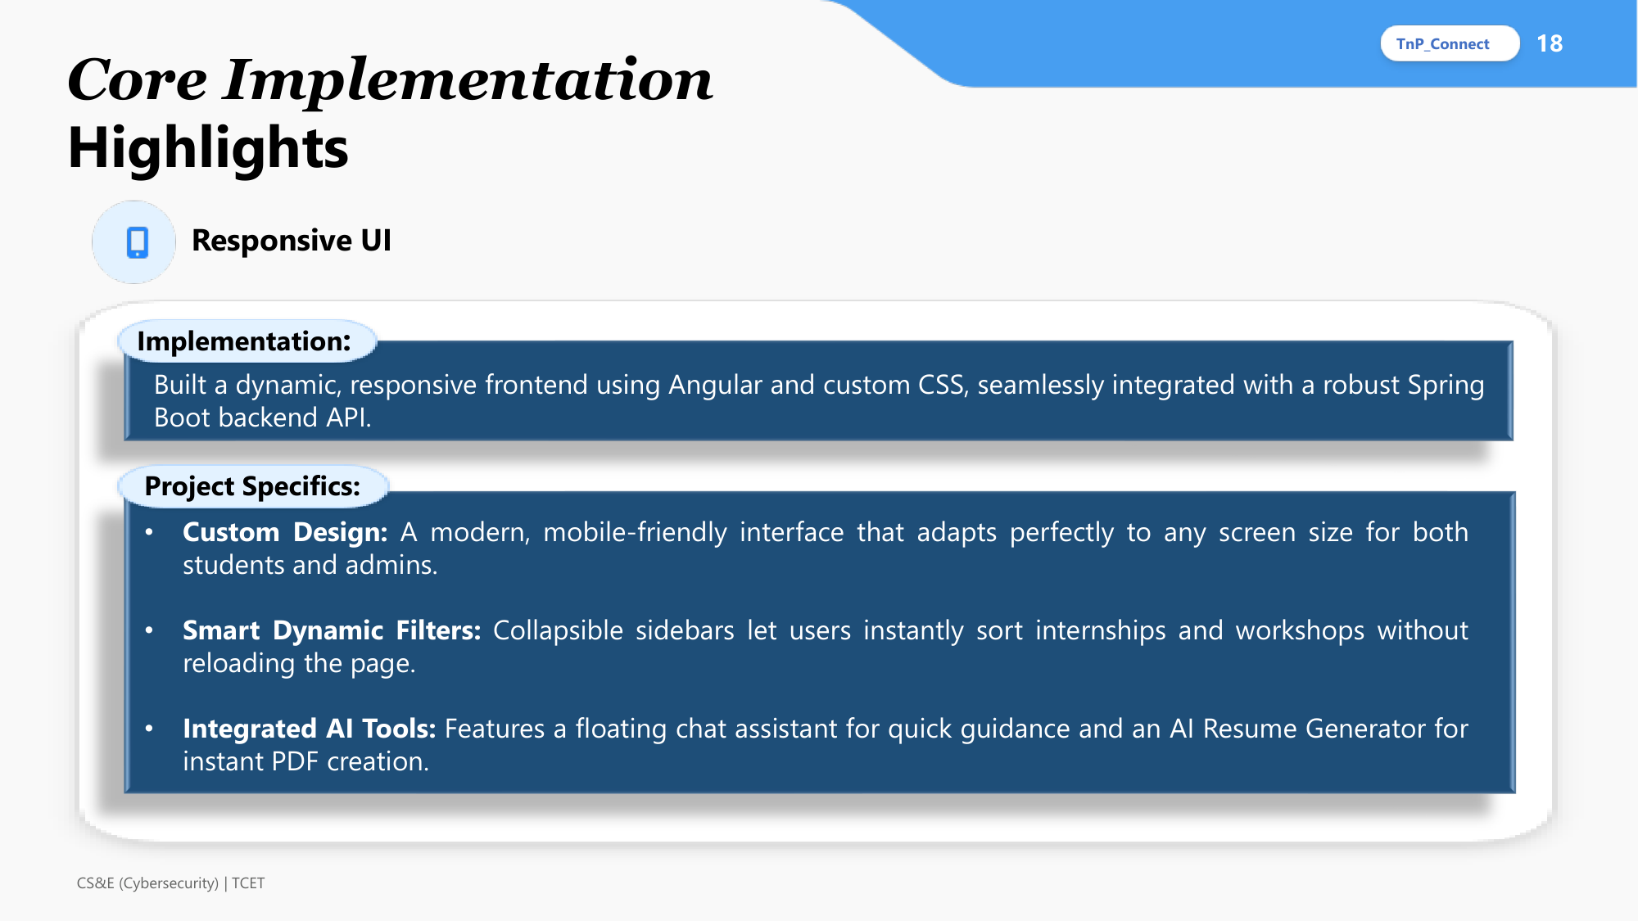
Implementation - Responsive UI
18

Slide 19

Thank You
19

